Slide 1
Exploring the effects of the expo line expansion on crime in Santa Monica

Slide 2
Preliminary Analysis
Use “Police Incidents” data set from Santa Monica open data portal
Subset data to include only months June through October for all years

Slide 3
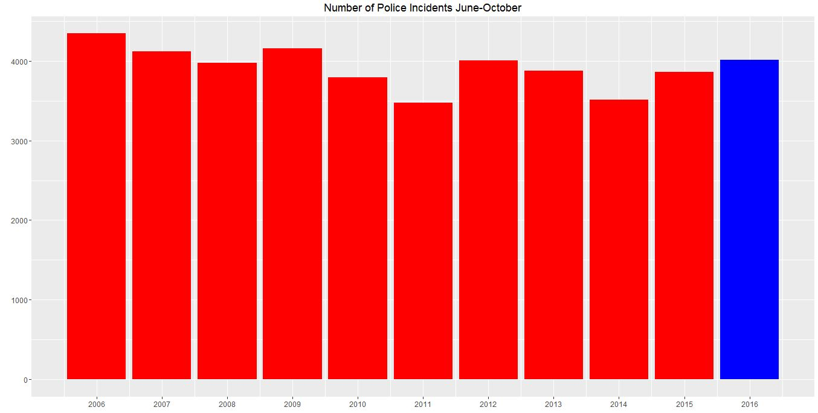
Preliminary Analysis (Results)

Slide 4
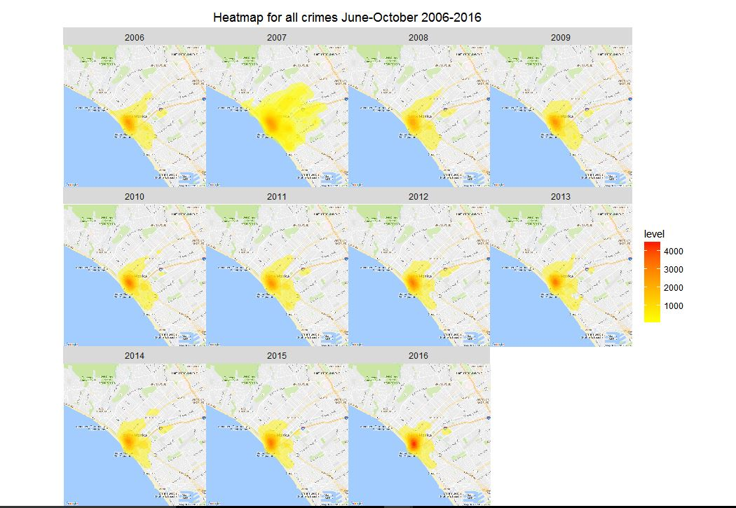
Preliminary Analysis (Results)

Slide 5
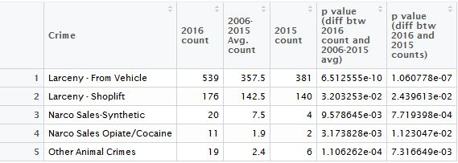
Which Crimes saw significant increase?

Slide 6
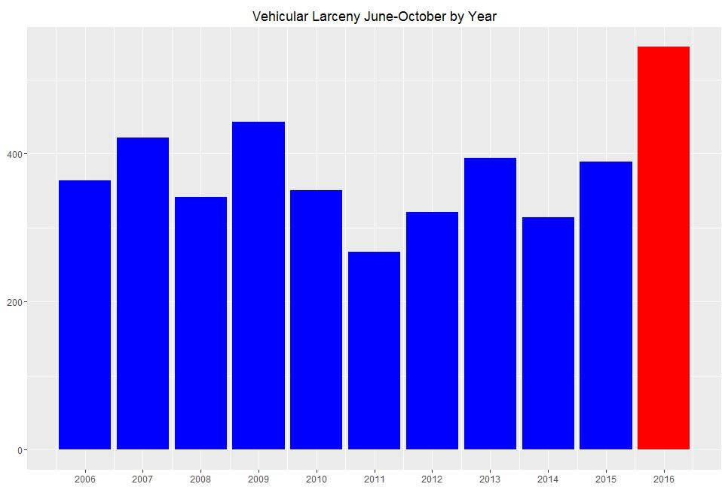

Slide 7
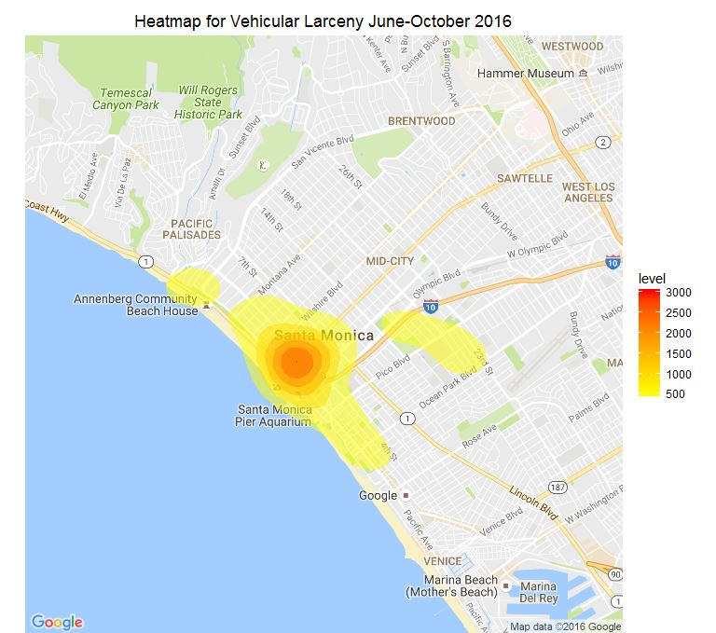
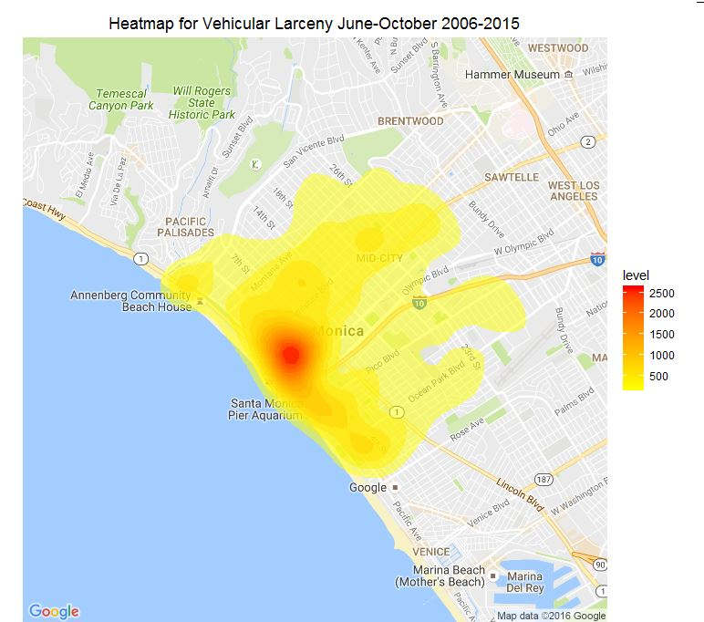

Slide 8
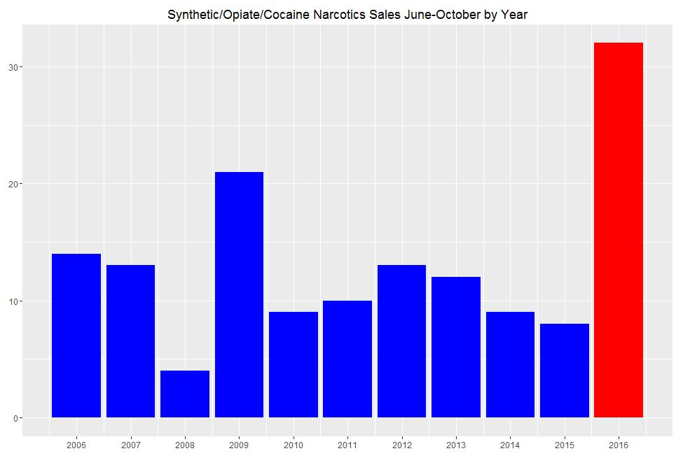

Slide 9
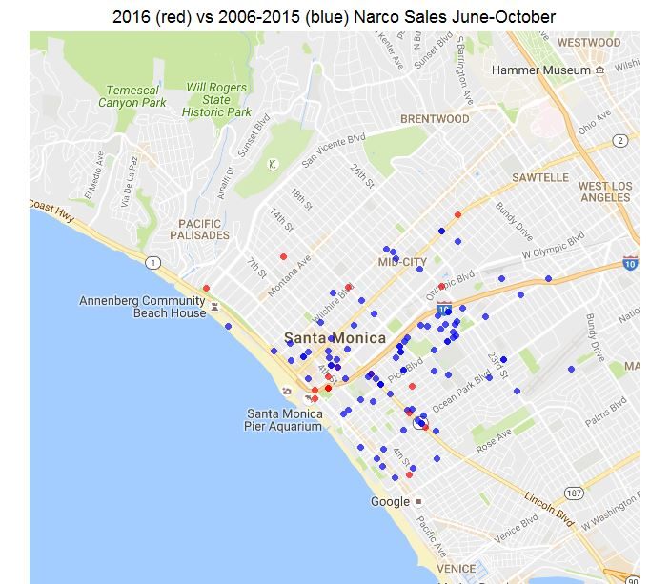

Slide 10
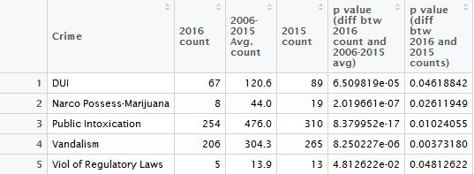
Which Crimes saw significant decrease?

Slide 11
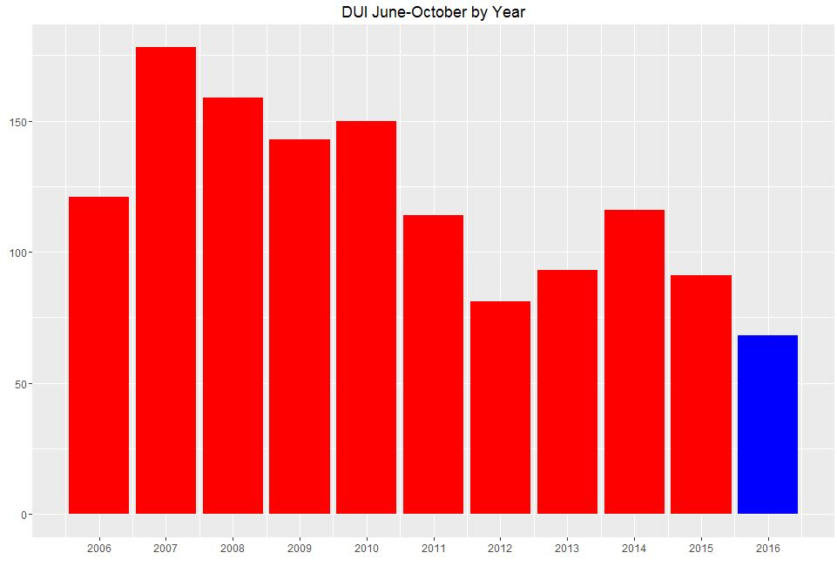

Slide 12
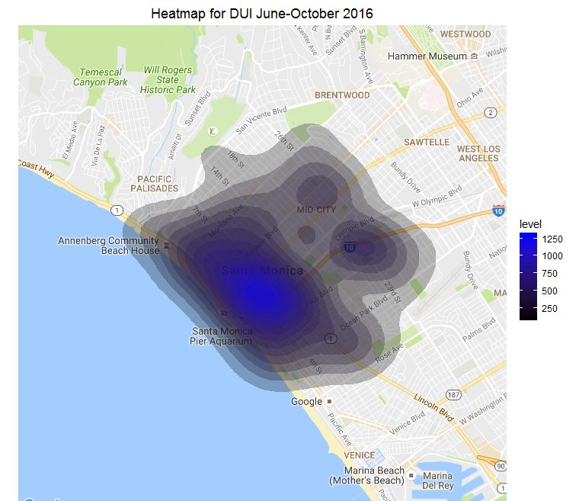
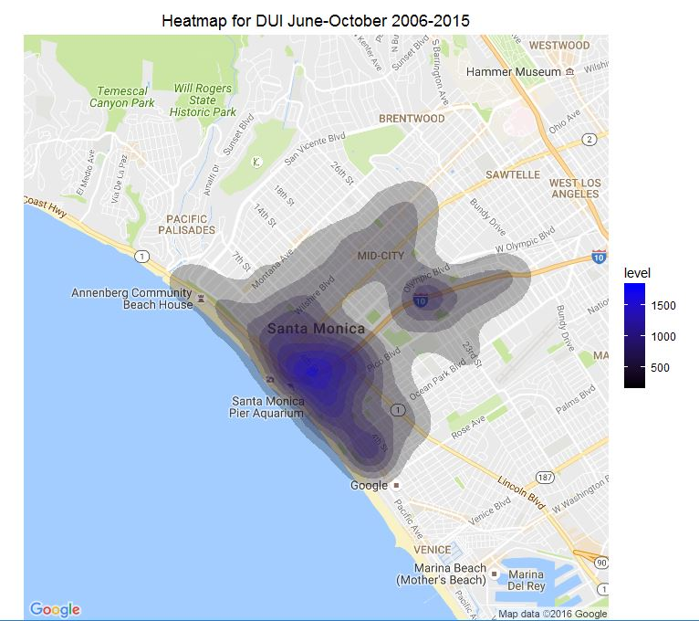

Slide 13
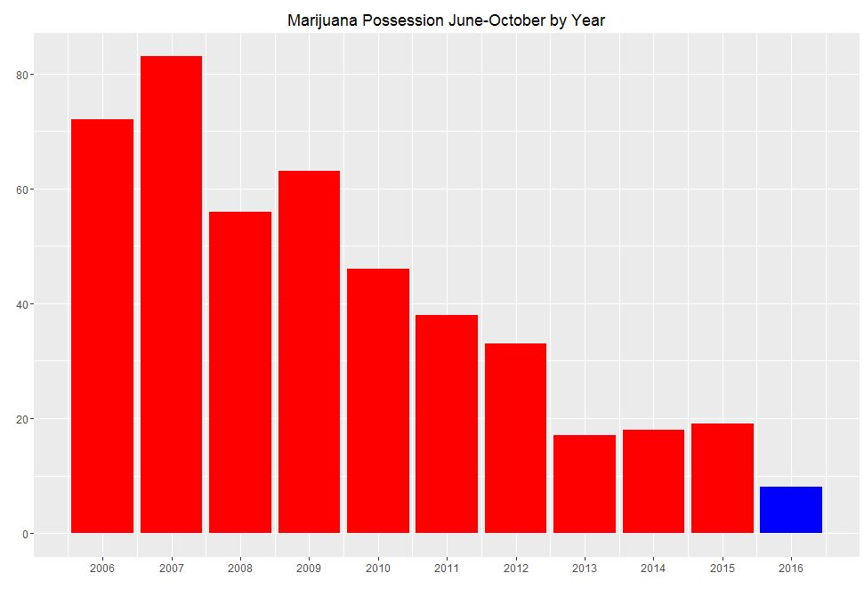

Slide 14
Major Takeaways
Since the train has arrived, both shoplifting and vehicular larceny have significantly increased, with vehicular larceny in particular seeing a large spike. It is likely that the train is causal.
Sales of synthetic narcotics as well as opiates/cocaine has significantly increased since the expo line has been completed.
The train has seemingly been effective in preventing DUIs.
Since the train arrived there have been very few instances of marijuana possession, although this seems to be following a downward trend even before the train was completed.

